Slide 1

Multichannel Nanoreporters for the Oilfield
Chih-Chau “Garry” Hwang,¹ Lu Wang,² Gedeng “Gordon” Ruan,¹
Zachary Schaefer,³ Wei Lu,¹
Michael S.Wong,^{1,3} Amy T. Kan,² Mason B. Tomson,² James M. Tour¹
¹Department of Chemistry
²Department of Civil and Environmental Engineering
³Department of Chemical and Biomolecular Engineering
Rice University, Houston, TX, 77005
All work presented here was funded in whole or in part by the Advanced Energy Consortium

Slide 2

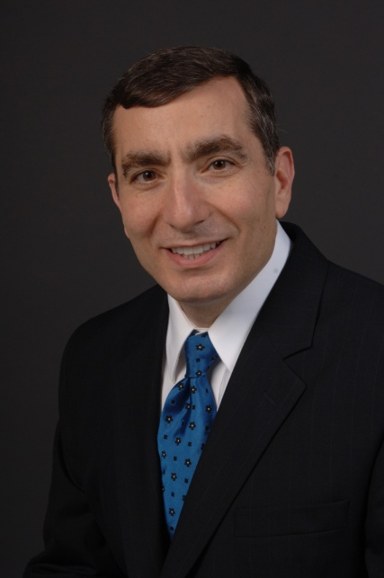

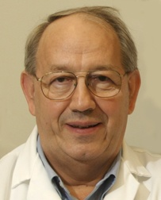

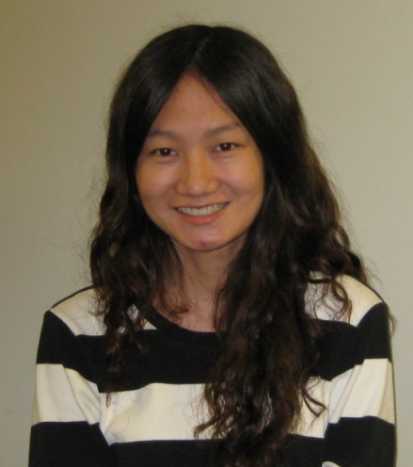
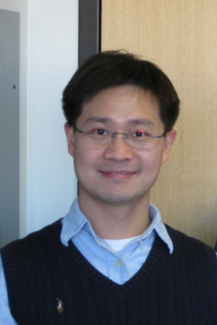

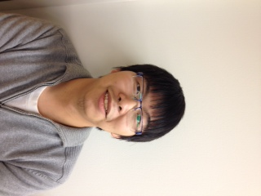


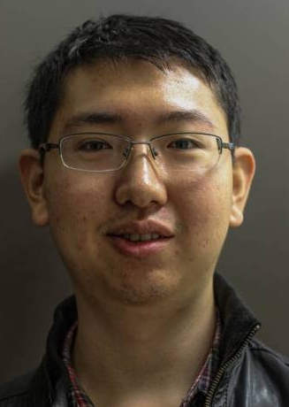
Project Team Members
Jim T.
Mike W.
Mason T.
Amy K.
Lu
Garry
Gordon
Paul
Charles
Varun
Yinhong
2

Slide 3
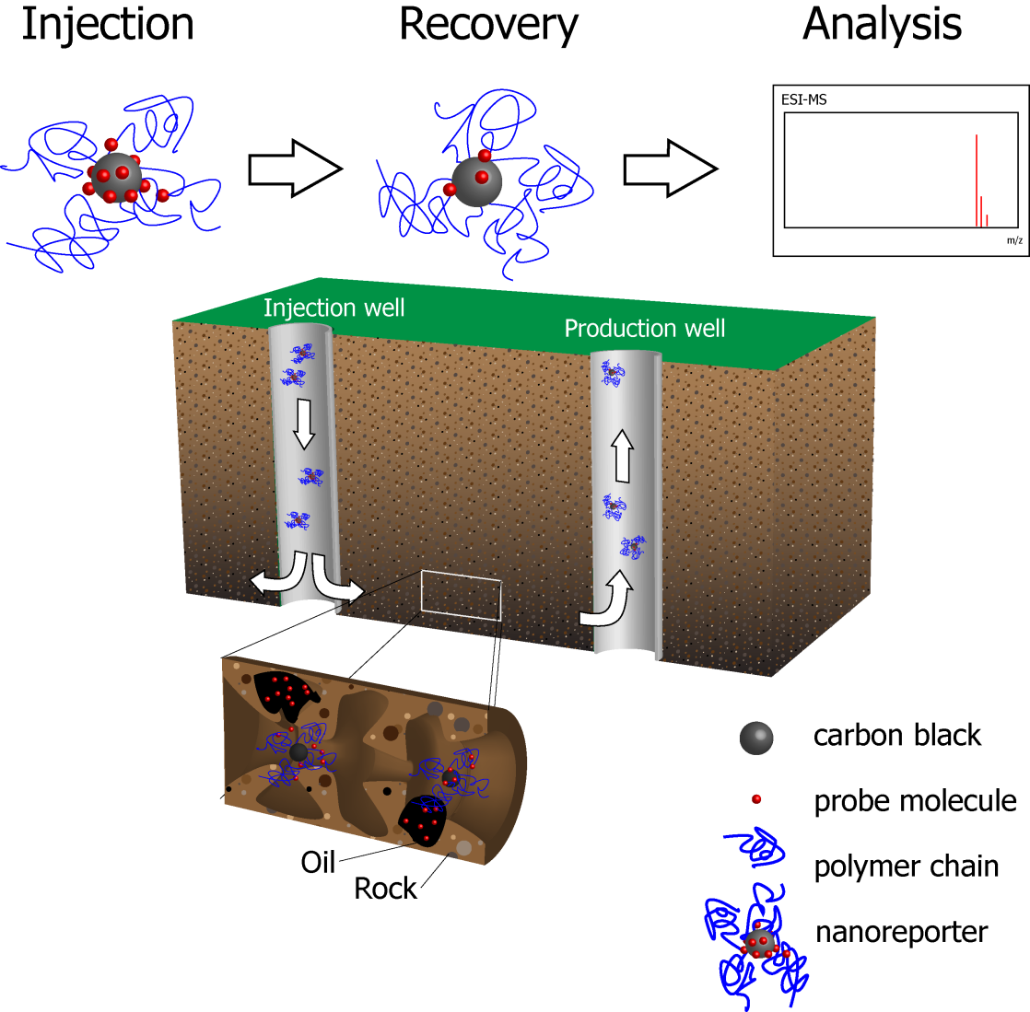
Schematic of Oil Detection by Nanoreporters
Nanoparticles (NPs) with hydrophobic signaling cargo (red rectangles) are injected into the subsurface.
The nanoreporters encounter oil and release their hydrophobic signaling cargo into the oil.
The nanoreporters are recovered and analyzed for the signaling cargo for the existence of saturated oil residual (SOR).
Core material: functionalized carbon black (“fCB”)
Cargo molecules: triheptylamine (TPA) or ¹⁴C-labeled triphenylamine (TPA*)
Batch desorption studies were conducted to understand the partition behavior of TPA
3

Slide 4
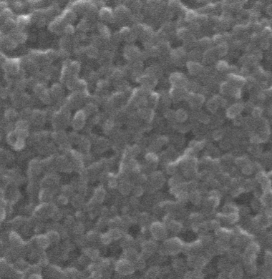
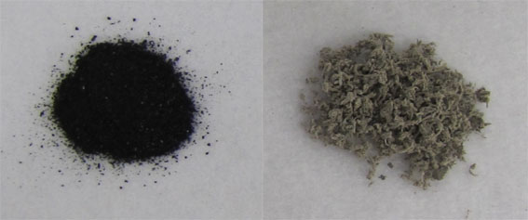
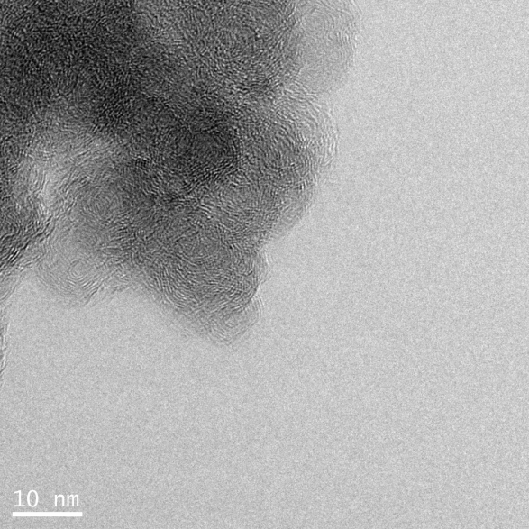
Early Work: Carbon Black-based Formulation
SEM image of 50 nm carbon black (CB)
A heavily oxidized and
carboxylated carbon core
PVA-OCB NPs
H₂SO₄, H₃PO₄
KMnO₄, 50 ºC
CB
powder
PVA-OCB
powder
100 nm
Cabot (MA, USA)
  Zeta potential of PVA-fCB is 3.84x10⁻¹ mV
  PVA-fCB is almost neutral and it will not bind to charged porous media
TEM of 15 nm fCB
4
Notes:
4
Early work on carbon black, now we are switching to magnetite as well.

Slide 5
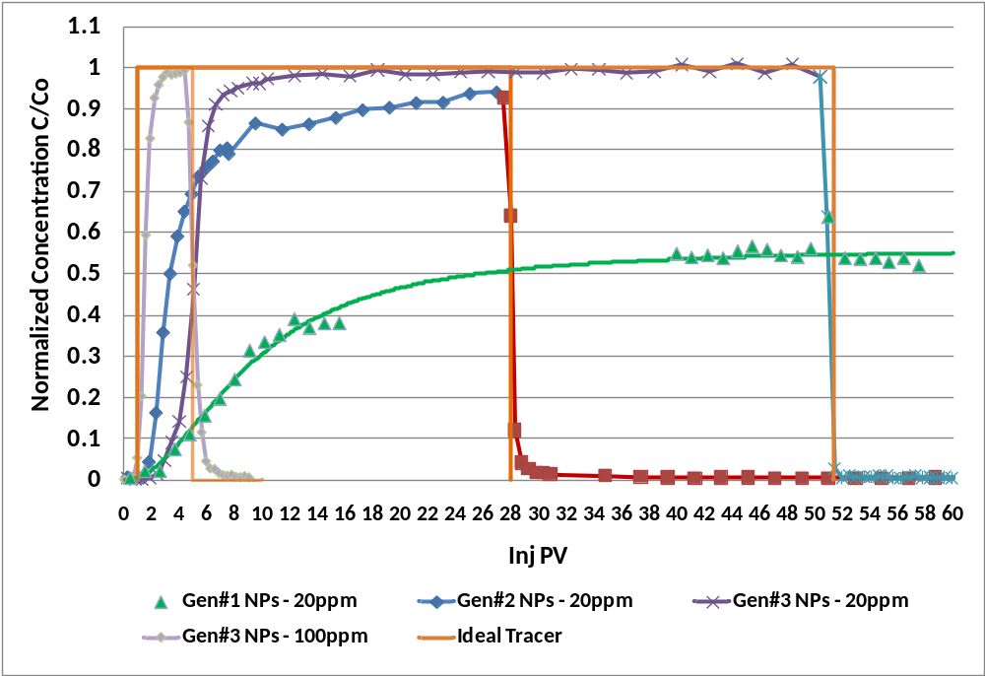
Transport Studies in Berea Sandstone – HCCs-PEG (Gen#1), OCB-PVA (Gen#2), CB-PVA (Gen#3)
Experimental Details
Sample: NPs in 31 kppm seabrine
Core size: 1” (D) x 1.5” (L)
Core type: Berea Sandstone
Core Permeability: 300mD
T = 28 ºC
Outlet P = 1 atm
Injection rate: ~0.1 cc/min
Linear velocity: 0.113 cm/min (5.3 ft/day)
Gen#3 – Acceptable Performer
Gen#1 – Poor Performer
Retention of Gen#3 particles: 10 micrograms/g of Berea Sandstone

Slide 6
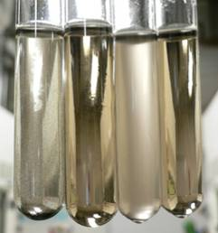
Stabilization of carbon-based NPs in brine solution
(A)
(B)
(C)
(D)
In seawater
OCB at RT
PVA(2K)-OCB at RT
PVA(2K)-OCB at 70 °C
PVA(50K)-OCB at 70 °C
Without polymer coating, OCB (15 nm) is very sensitive to temperature and salt ions
50 K MW of PVA is required for stabilization of CB
The temperature-sensitivity of PVA is dependent on the molecular weight
6
Notes:
6
All based on 15 nm CB. Generally, we put error bars for mean diameter data since it is dynamic. But, we did 10-minute run rather than 5 runs (2 min/run).
6

Slide 7
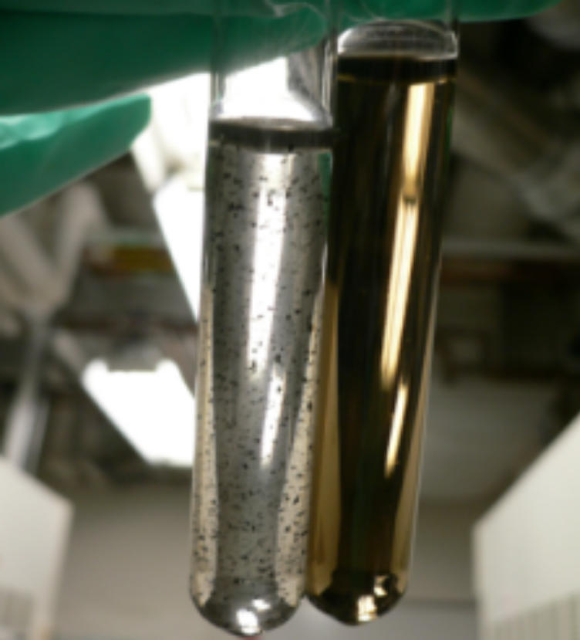
Stability of Sulfated PVA Coated CB
sPVA:
Awaiting XPS data
HsPVA: Highly sulfated PVA
4.5 mL 1 M ClSO₃H/CH₃COOH, 75 °C
LsPVA: Lightly sulfated PVA
3.0 mL 1 M ClSO₃H/CH₃COOH, 60 °C
PVA (50 K)-fCB (left) vs. LsPVA (50 K)-fCB (right)
in API standard brine at 100°C
API brine (Ionic Strength 3.77 M): NaCl (1.4 M), CaCl₂ (0.19 M)
Synthetic seawater (Ionic Strength 0.55 M): CaCl₂ (3.5 mM), MgCl₂ (5.5 mM), KCl (19.8
mM), NaCl (0.5 M), Na₂SO₄ (0.5 mM), NaHCO₃ (2.0 mM)
7
Notes:
7

Slide 8
Nanoparticles Transport in API Solution at 70 ºC
LsPVA-fCB
LsPVA-fCB
Calcite columns
Sandstone columns
HsPVA-fCB
PVA-fCB
HsPVA-fCB
PVA-fCB
No. of pore volume
No. of pore volume
More than 90% of sPVA-fCB can flow through calcite and sandstone columns at 70 ºC in API brine
sPVA(50 K)-fCB was dispersed in API brine (8 wt% NaCl, 2 wt% CaCl₂)
The concentration of nanoparticles was 20 mg/L
8

Slide 9
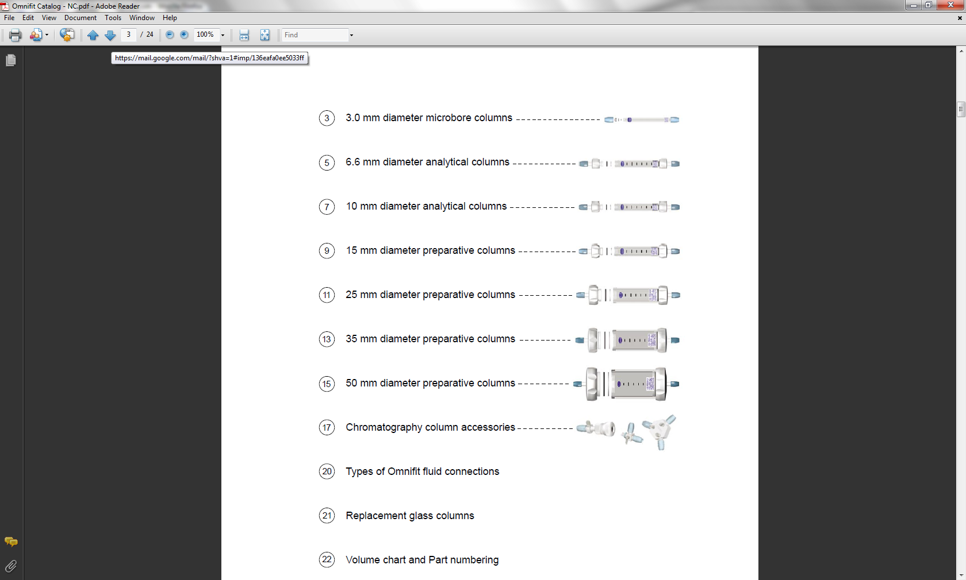
Apparatus for Breakthrough Study
UV-Vis
LsPVA-CB
Glass column
ICP-OES
PVA-PAA-Fe₃O₄
Inductively Coupled Plasma Optical Emission Spectrometry
(ICP-OES)
GC glass
GC glass
vial
Plastic syringe
vial
Plastic syringe
x
x
ESI-MS
THA (Triheptylamine)
ESI-MS
Syringe pump
Electrospray Ionization Mass Spectrometry
(ESI-MS)
Syringe pump
Scintillation counter
¹⁴C-TPA
(Triphenylamine)
Gound core material (106-250 μm)
Berea sandstone
Calcite
9
Notes:
9

Slide 10
Breakthrough Studies in Different Oil Content Columns
Breakthrough of TPA/sPVA-fCB in sandstone-packed columns at 25 °C (a) without isoparL; (b) with 29% isoparL in column and (c) with 58% isoparL in the column
Flow rate is 8 mL/h (linear velocity 12.2 m/d)
x is the oil saturation in the column and k_{p} is the partition coefficient (1.03*10⁻⁴ kg-NP/L). More experiments are necessary to verify the correlation
10

Slide 11
Correlation Studies under More Realistic Conditions
Nanoparticles were dispersed in API brine, the concentration of sPVA-CB was 30 mg/L
Columns were packed with ground calcite with oil saturation 0.58 (the volume of isoparL/PV)
The release of probe molecules only slightly depends on the flow rate
More experiment details will be shown in the poster section
11

Slide 12
Correlation Studies under More Realistic Conditions
Nanoparticles were dispersed in API brine, the concentration of sPVA-CB was 30 mg/L
Columns were packed with ground calcite with oil saturation 0.58 (the volume of isoparL/PV)
The release of probe molecules only slightly depends on the flow rate
12

Slide 13
Correlation Studies under More Realistic Conditions
Nanoparticles were dispersed in API brine, the concentration of sPVA-CB was 30 mg/L
Columns were packed with ground calcite with oil saturation 0.58 (the volume of isoparL/PV)
Two kinds of columns are used in the study: 6.5 cm and 11.6 cm
The release of probe molecules only slightly depends on the flow rate and column length
13

Slide 14
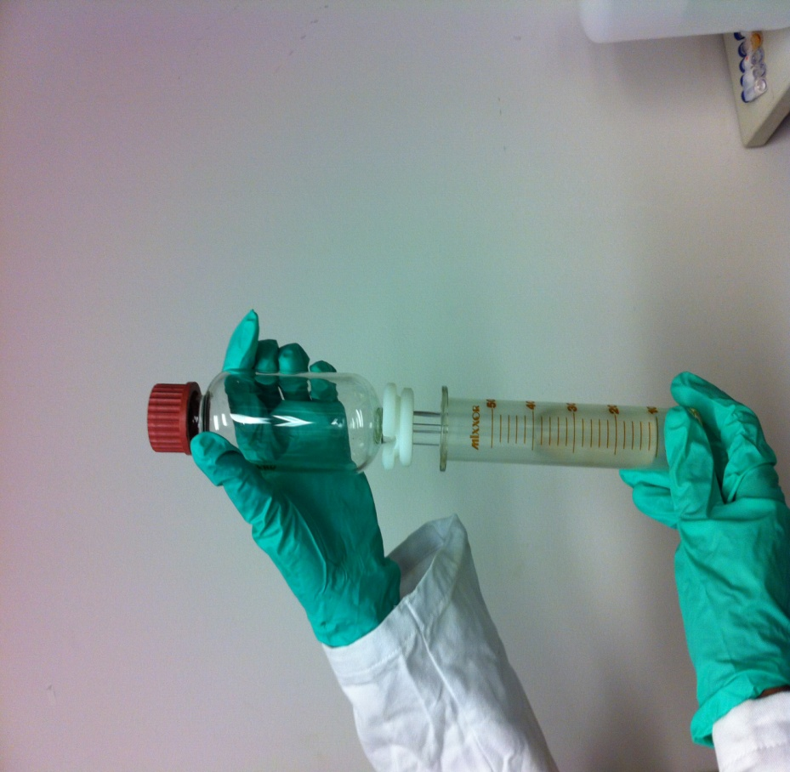
TPA* Partition Kinetics
Apparatus used to mix solution
TPA* was used as the probe molecule and isooctane was used as the oil phase
5 mL isooctane and 5 mL sPVA-fCB in API brine were mixed and the concentration of TPA* in the aqueous phase was monitored every 2 minutes
Kinetics studies show the desorption reaches equilibrium at 8 min
14
Notes:
At ~ 8 min, the C/C0 reaches the plateau region: indicating that no more TPA is leached out from the sPVA-fCB.

Slide 15
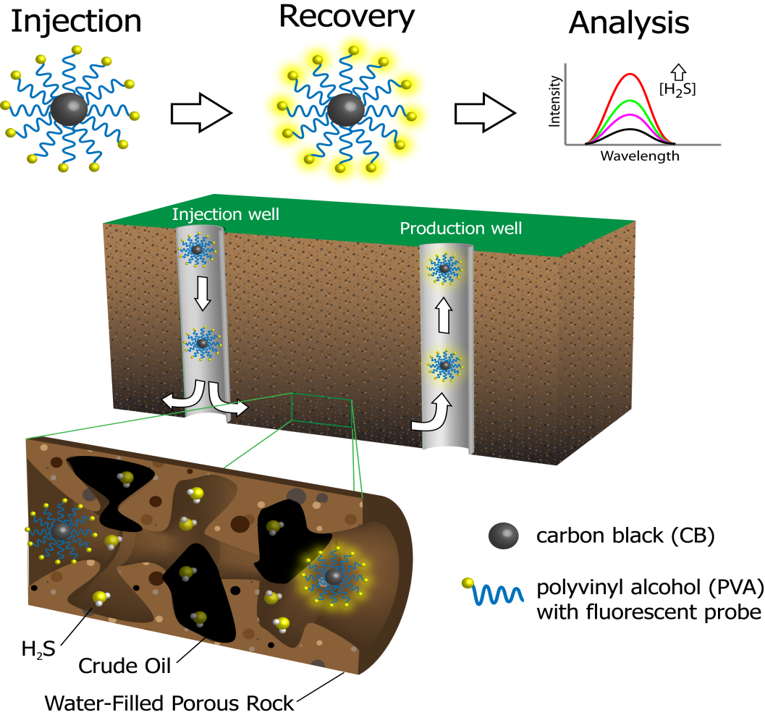
Nanoreporter for H₂S Detection in Subsurface
Naphthalimide-based Nanoreporter
Fluorescent probe-modified PVA-fCB (FP-PVA-fCB)
2 EWG:
in a pull-pull way
ICT is forbidden
1 EDG + 1 EWG:
in a push-pull way
ICT is allowed
Non-fluorescent
Fluorescent
ICT: intramolecular charge transfer
15

Slide 16
Apparatus for Breakthrough Study
Nanoreporters
Syringe pump
UV-vis
spectrometer
NPs
GC glass
vials
Na₂S solution
Fluorescence
spectrometer
Fluorescent
probes
Syringe pump
Ground core materials: sandstone (provided by AEC)
Flow rate: 0.6 mL/h for each syringe, retention time 1 h
Nanoparticles were dispersed in synthetic seawater
Temperature: 25 °C
16

Slide 17
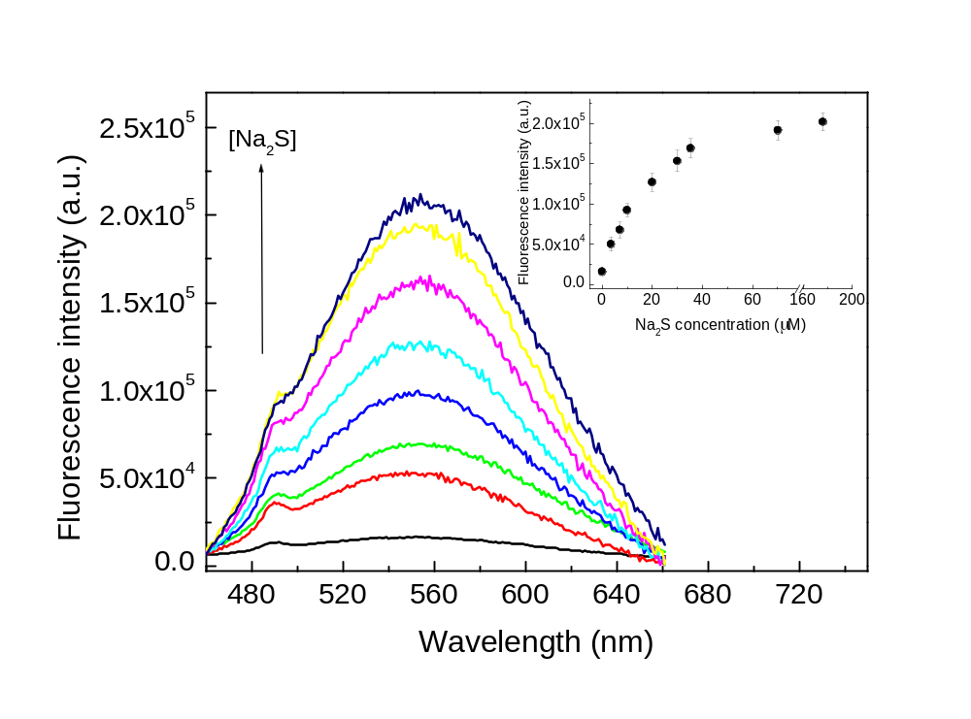
FP-PVA-fCB Nanoreporter for H₂S Detection
50 μM FP-PVA(50k)-FCB and various concentrations of Na₂S_{(aq)} (0~170 μM) were injected to the column simultaneously.
The fluorescence increase showed a linear correlation with the injected Na₂S_{(aq)}, and reached 11-fold enhancement as 70 μM Na₂S_{(aq)} reacted with the nanoreporter.
17

Slide 18
Conclusions
  1. The flow rate and column length only slightly influence the release of probe molecules from nanoreporters
  2. Kinetics study indicates that the desorption equilibrium of TPA* from nanoparticles could be reached in 8 min
  3. New nanoparticles have been prepared that are designed for sensing H₂S
  4. Temperature-responsive magnetite nanoparticles have been developed for imaging reservoirs
  Future Work
  1. Transport studies of nanoreporters under more realistic conditions
  2. Optimization of the synthesis of H₂S-responsive nanoreporters
18
Notes:
18

Slide 19
Functionalized Nanoparticles for Enhanced Oil Recovery at High Temperature and Salinity
Gedeng “Gordon” Ruan,¹ Hadi ShamsiJazeyi,² Chih-Chau “Garry” Hwang,¹
Varun Shenoy Gangoli,² Zhiwei “Paul” Peng,¹ Changsheng “Charles” Xiang¹
Yinhong Cheng,² Maura Puerto,² Rafael Verduzco,² Michael S.Wong,^{1,2}
Clarence A. Miller,² George J. Hirasaki,² James M. Tour¹
¹Department of Chemistry
³Department of Chemical and Biomolecular Engineering
Rice University, Houston, TX, 77005
All work presented here was funded in whole or in part by the Advanced Energy Consortium
19

Slide 20



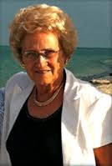

Project Team Members
Jim
George
Clarence
Mike
Rafael
Maura
Gordon
Garry
Paul
Charles
Hadi
Varun
Yinhong
20

Slide 21
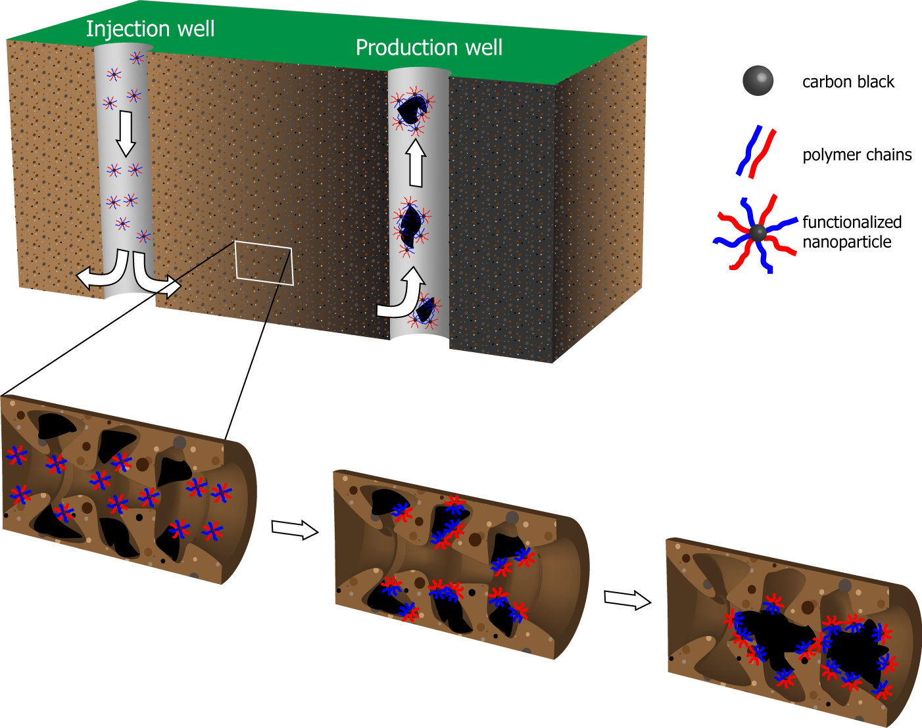
MPNPs for EOR
Injection of MPNPs results in coalescence of oil droplets in porous rocks to form growing oil banks
Polymer-thickened water is injected to effectively push or displace the oil banks through the reservoir, followed by ordinary brine
Facile separation of the oil phase post production of emulsion: temperature-responsive solubility of MPNPs in oil phase
21
Notes:
Principle of MPNPS. Ordinary brine is injected due to its low cost. One of the biggest issues with surfactant EOR is the breaking microemulsion after oil recovery, since the microemulsion is thermodynamically stable and it is not easy to break the emulsion. The advantage of MPNPs is that we may be able to break the emulsion using the temperature-responsive solubility of MPNPs in oil phase at high temperature.

Slide 22
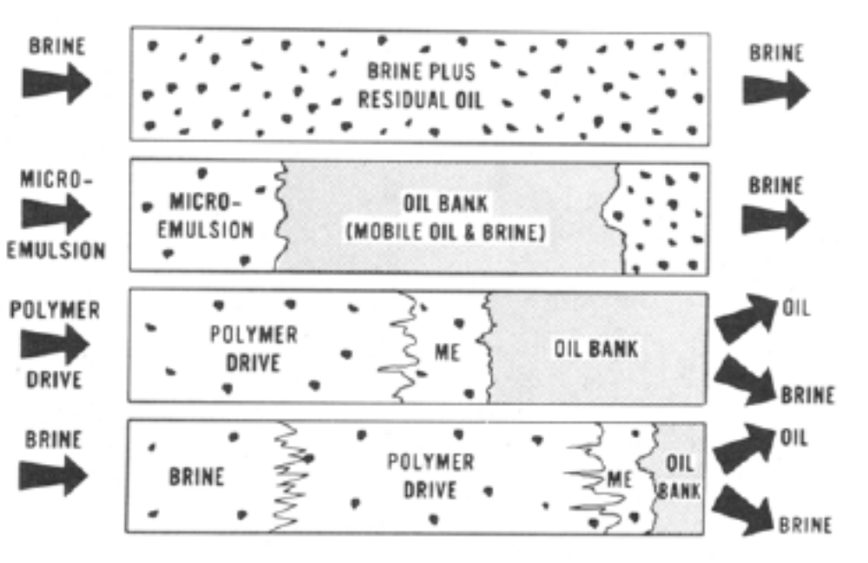
Conventional surfactant flooding for EOR
Enhanced Oil Recovery (EOR)
Injection of water results in only water being produced
An effective way to introduce the surfactant is via a stable microemulsion containing oil, brine and surfactant
The microemulsion mobilizes the trapped oil to form a growing oil bank driven ahead of the surfactant bank
Polymer-thickened water is injected to effectively push or displace the microemulsion bank through the reservoir, followed by ordinary brine
Injection well
Production well
Surfactant flooding
Inject NPs here
Amphiphilic carbon-based nanoparticles will be designed to lower the interfacial tension for enhanced oil recovery.
Interfacial area
Interfacial tension,
Note: 1 mN/m = 1 dyne/cm
10⁻⁴ - 10⁻² mN/m (required for ΔG < 0)
22
J. Am. Oil Chemists' Soc., 1982, 59, 839.
Notes:
This paper describes the basic principles of surfactant flooding for EOR. To form microemulsion spontaneously, the interfacial tension should be in the range of 10-4 to 10-2 m/Nm. Delta A is the change in the interfacial area. Microemulsion: thermodynamically stable, size of emulsion is <100 nm, and transparent.
Please move the last sentence upward as it might get cut from the screen

Slide 23
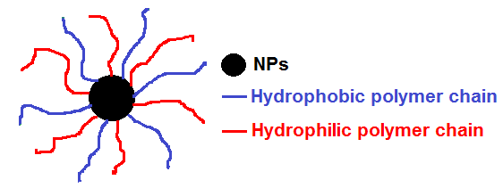
Why are nanoparticles (NPs) being used?
Ultra-small
Easy to synthesize and control the particle size and shape
Convenient to be delivered and be recovered
In-situ detection of the physical and chemical properties of the oil reservoir
Capable to integrate multifunctionalities to lower the production cost
MPNPs
What could MPNPs do?
Mobilize oil droplets to form oil bank
Detect the residual oil saturation (sequestered tracers)
Detect the local environments (pH, H₂S, CO₂, pressure, salinity) (stimuli-responsive coating)
Composition of nanoparticle “core” (≤ 15nm) : carbon-based, silica-based, and magnetic NPs with carbon shell
The polymer brush will impart the stimuli-responsive properties to NPs
23
Notes:
23

Slide 24




Temperature-responsive MPNPs for EOR
OCB (or f-CB) could be coated with the mixture of hydrophobic and hydrophilic polymers
Interfacially active MPNPs
Lower T
Aqueous phase
Intermediate T
Interface
High T
Oil phase
Hydrophobic polymer (PE-b-PEG, polycaprolactone, polyethylene, etc. )
Hydrophilic polymer (polyvinyl alcohol, polyvinylpyrrolidione, etc. )
By tuning the molecular weight of the hydrophobic polymers or choosing different stimuli-responsive polymers, we will be able to selectively position the MPNPs in the water/oil mixture with applications in:
- EOR
- Easy separation of produced emulsion
- Solubilization of asphaltenes
24
Notes:
Some specific objectives are added here to make this one look like an overview slide for the following ones.
24

Slide 25
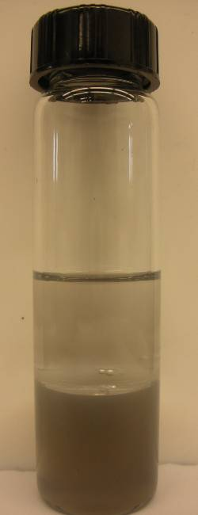
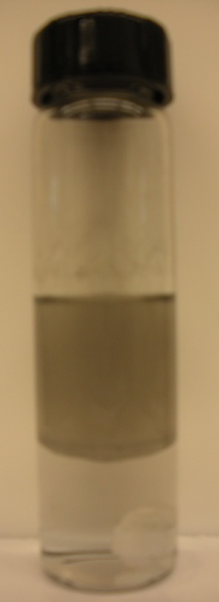
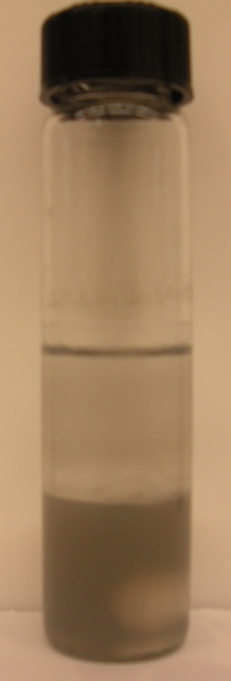
Recent work: Temperature-responsive NPs
Proof of principle: Reversible NP migration across oil/water interface
110°C, stirring
RT
20 min
stirring
PE-b-PEG-OCB (~ 40 mg/L)/brine solution (PE-b-PEG Mn=1400)
Due to the solubility of polyethylene block in isooctane at high temperature, the polyethylene block can drag the hydrophilic OCB to isooctane phase.
25

Slide 26
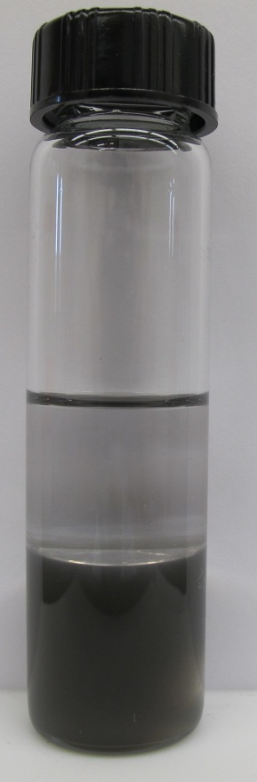
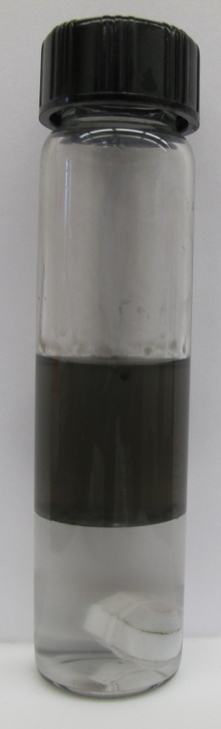
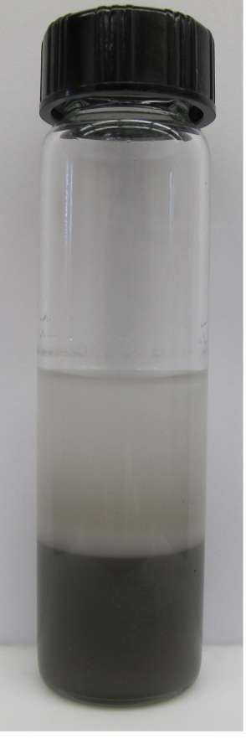
Temperature-responsive NPs
Transport of NPs across oil/water interface
90 ºC, stirring
Room temperature
1 h
stirring
PE-b-PEG-OCB (~ 40 mg/L)/brine solution (30-40 nm OCB; PE-b-PEG: Mn=920)
Phase inversion temperature can be tuned by using different molecular weight of the diblock copolymer: lower molecular weight, lower phase inversion temperature
Phase inversion temperature correlates with the melting temperature of the hydrophobic block
PE-b-PEG: polyethylene-b-polyethylene glycol, 50 wt. % of ethylene oxide
Mn=920 Phase inversion temperature 90 ºC
Mn=1400 Phase inversion temperature 110 ºC
26
Notes:
The demonstration of amphiphilic NPs was done on 30-40 nm OCB. The melting temperature of this polymer is ~105 C but it can migrate to oil phase at relative lower temperature.

Slide 27
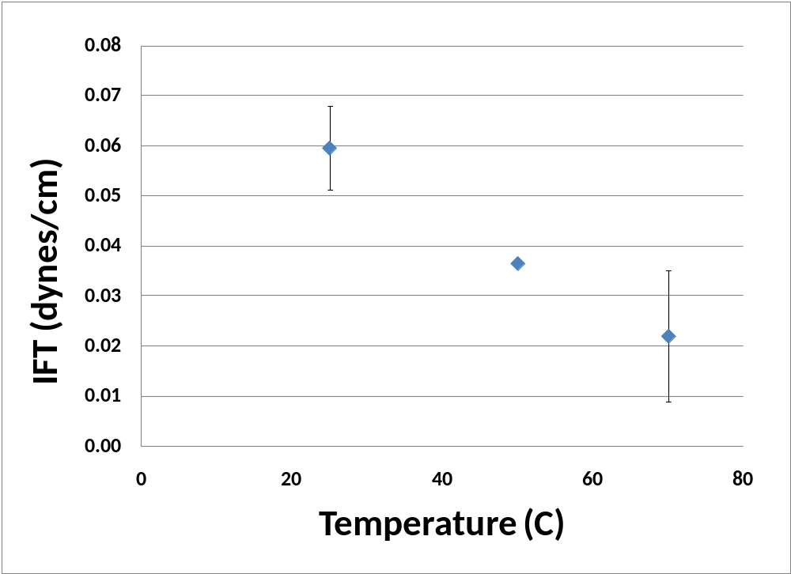


Interfacial tension reduction with amphiphilic NPs
Spinning Drop Tensiometry
Oil droplet
σ: Interfacial tension (IFT) between oil and water
R : Radius of Cylinder
Δρ: Density difference between oil and water
ω: Rotation speed of capillary
Range of IFT Measurements: 10⁻³ mN/m – 10 mN/m
T range: 20 ºC to 85 ºC
IFT reduction of isooctane from 50 dynes/cm to ~ 0.02 dyne/cm
Note: 1 mN/m = 1 dyne/cm
The amphiphilic OCB can migrate to organic phase at 90 ºC
Equal volumes of isooctane and amphiphilic OCB were mixed and equilibrated at 90 ºC for
24 hours
The interfacial tension of equilibrated isooctane with amphiphilic OCB at three different
temperatures were measured using spinning drop tensiometry
27
Notes:
27
Only specific oil/water mixture can show very low IFT values, around ~0.001mN/m. We did not have IFT for amphiphilic OCB that can migrate to oil phase at 110 C but we will run it. Gautam got inconsistent value for that one, when he did the measurements. I have bought three spinning drop tubes for IFT measurements and we will continue on this next week.

Slide 28
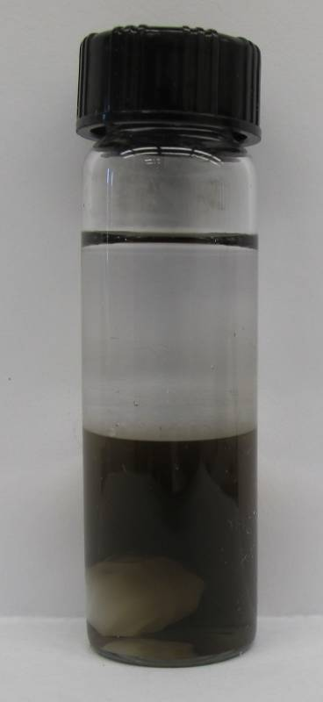
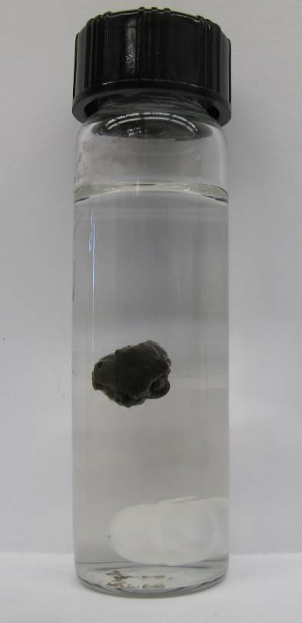
Temperature-responsive polymer coated OCB
80 ºC, 15 min
Stirring
Isooctane
Water
Poly(N-isopropylacrylamide)-OCB in brine (~ 30 mg/mL)/isooctane
Poly(N-isopropylacrylamide) is a temperature-responsive polymer, which starts to expel water from itself at 32 ºC
Poly(N-isopropylacrylamide) is not soluble in isooctane
Introducing hydrophobic block to poly(N-isopropylacrylamide) could make OCB or f-CB more soluble in the isooctane phase
Progress in Polymer Science, 1992, 17 , 163–249.
28

Slide 29
Current efforts-starting to acquire a baseline understanding
  Hydrophilic NPs sPVA-OCB make a homogenous dispersion in brine and seems to make Pickering emulsions at ~ 25°C
  Hydrophobic NPs, C16-OCB and C22-OCB, stay at the interface between brine and toluene at 100 ºC.
  Amphiphilic NPs, C12-OCB-sPVA, C16-OCB-sPVA, C22-OCB-sPVA, make W/O emulsion at high-temperature high-salinity. The NPs of this formula is still too hydrophilic.
  ¹H NMR quantification method is established to estimate the ratio of sPVA / alkyl ratio.
29
Notes:
29

Slide 30
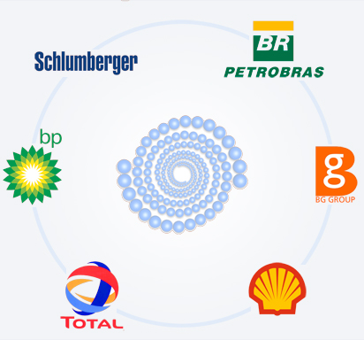
Funding

